Slide 1
Agenda
01 Bayesian Statistics
02 Markov Chains
03 Monte Carlo Methods
04 MCMC
05 Metropolis-Hastings algorithm
06 Python with MCMC M-H
07 Closing Q&A

Slide 2
Introduction
00
We need to define:
Bayesian Statistics
Markov Chains
Monte Carlo methods
MCMC
Metropolis Hastings algorithm

Slide 3
Introduction to Bayesian Statistics
01

Slide 4
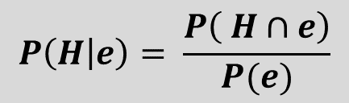
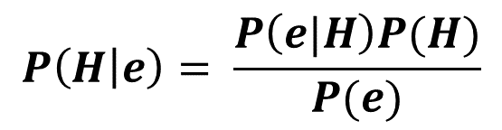
Bayesian Statistics
01
Deriving Bayes Rule:
Let H and e be two events, then the conditional probability of H given e is defined as the ratio:
Observe in particular
We obtain the relation
Bayes theorem:
$$P\left(H | e\right)= \frac{P\left( H∩e\right)}{P(e)}$$
$P\left(H | e\right)P(e)=$ $P\left( H∩e\right)$ = $P\left( e∩H\right)=P\left(e | H\right)P(H)$
$$P\left(H | e\right)= \frac{P\left(e|H\right)P(H)}{P(e)}$$
Notes:
See https://juanitorduz.github.io/intro_pymc3/
E.g. find the probability it is going to rain given that it is cloudy.
H = the event that it is going to rain
E = the event that it is cloudy

Slide 5
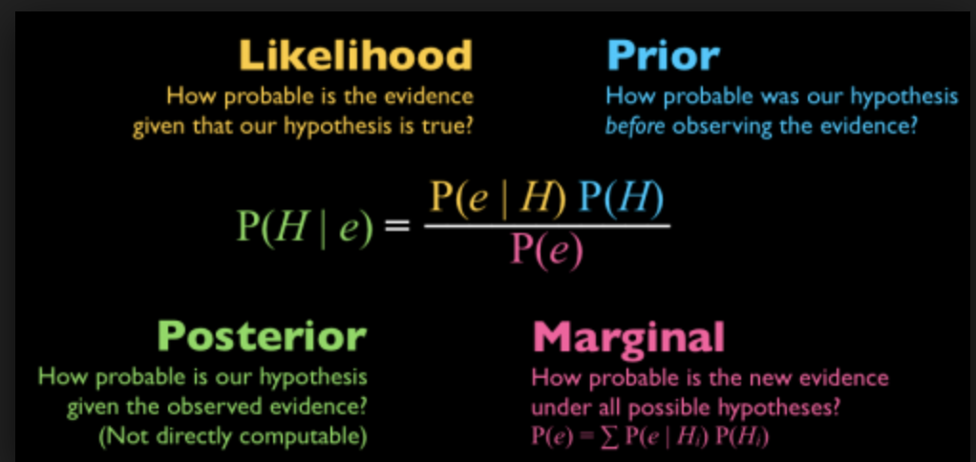
Bayesian Statistics
01
When we get new information, we should update our probabilities to take the new information into account. Bayesian methods tell us exactly how to do this.
Notes:
https://medium.com/@mark.rethana/bayesian-statistics-and-naive-bayes-classifier-33b735ad7b16 - image

Slide 6
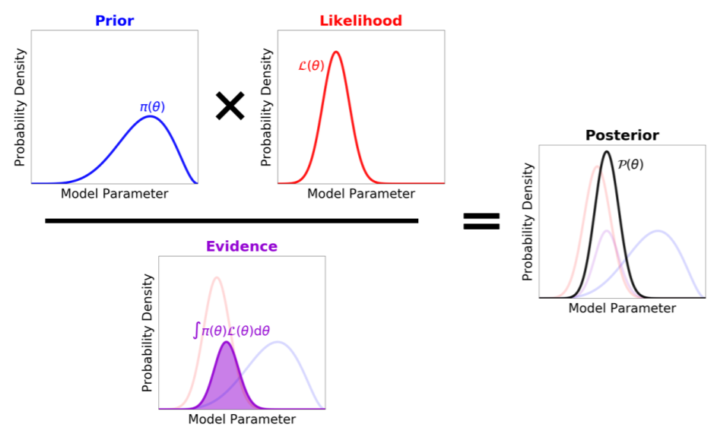
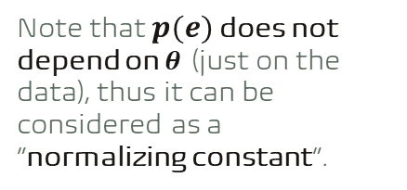
Bayesian Statistics
01
Note that $p(e)$ does not depend on $θ$ (just on the data), thus it can be considered as a “normalizing constant”.
Source: https://arxiv.org/pdf/1909.12313.pdf
Notes:
The Bayesian approach returns a posterior which is a distribution for the real value of theta, not a fixed value.

Slide 7
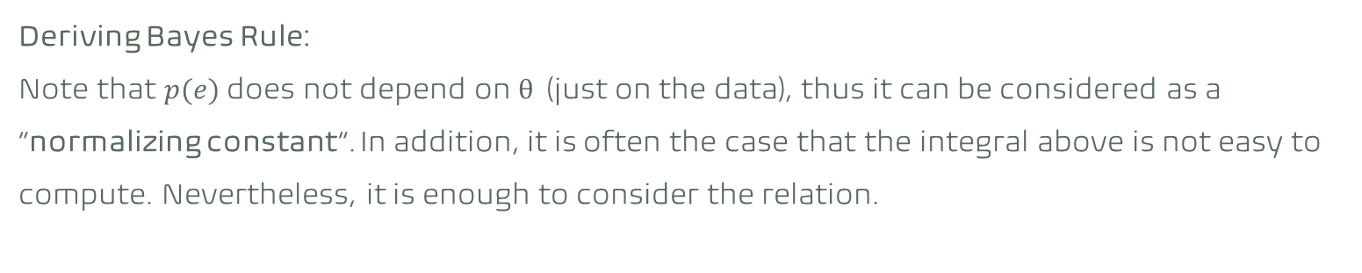
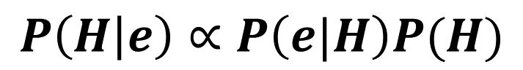
Bayesian Statistics
01
Deriving Bayes Rule:
Note that $p(e)$ does not depend on $θ$ (just on the data), thus it can be considered as a “normalizing constant”. In addition, it is often the case that the integral above is not easy to compute. Nevertheless, it is enough to consider the relation.
$$P\left(H | e\right)∝P\left(e|H\right)P(H)$$
Notes:
See https://juanitorduz.github.io/intro_pymc3/

Slide 8
Bayesian Statistics
01
What are Posteriors Good For?
Making educated guesses: make a reasonable guess at what the underlying model parameters are.
Quantifying uncertainty: provide constraints on the range of possible model parameter values.
Generating predictions: marginalize over uncertainties in the underlying model parameters to predict observables or other variables that depend on the model parameters.
Comparing models: use the evidences from different models to determine which models are more favourable.
Source: https://arxiv.org/pdf/1909.12313.pdf

Slide 9
Bayesian Statistics
01
“The essential difference between frequentist inference and Bayesian inference is the same as the difference between the two interpretations of what a “probability” means.”
Frequentist: probabilities are related to frequencies of events after many trials.
Long term AVR.
Bayesian: probabilities are related to our own knowledge about an event.
Degree of belief.
Notes:
Essentially the difference between the two ways of Inferencing, is the way we define probability. The main questions is “What is probability” and everything else is derived from there.
What is probability?
For a frequentist, a probability is something that is related to the frequencies of repeated events. If we say there is a 50/50 chance that a coin toss will land heads or tails, the reason we know that is because if we toss the coin over and over, 1000 times, somewhere around half of those will be heads and the other tails.
For a Bayesian, the probability is fundamentally related to our own certainty or uncertainty of events. When I say that I am 50% sure that this coin will land heads, as a Bayesian, it is not because I have sat there and tossed the coin 1000 times. But it is because I have somehow assigned some kind of probability to define that uncertainty of my knowledge. –it’s a 50/50 chance.
https://juanitorduz.github.io/intro_pymc3/

Slide 10
Bayesian Statistics
01
“The essential difference between frequentist inference and Bayesian inference is the same as the difference between the two interpretations of what a “probability” means.”
Frequentist is a method of statistical inference in which conclusions from data is obtained by emphasizing the frequency or proportion of the data.
Bayesian is a method of statistical inference in which Bayes’ theorem is used to update the probability for a hypothesis as more evidence or information becomes available.
Notes:
Essentially the difference between the two ways of Inferencing, is the way we define probability. The main questions is “What is probability” and everything else is derived from there.
What is probability?
For a frequentist, a probability is something that is related to the frequencies of repeated events. If we say there is a 50/50 chance that a coin toss will land heads or tails, the reason we know that is because if we toss the coin over and over, 1000 times, somewhere around half of those will be heads and the other tails.
For a Bayesian, the probability is fundamentally related to our own certainty or uncertainty of events. When I say that I am 50% sure that this coin will land heads, as a Bayesian, it is not because I have sat there and tossed the coin 1000 times. But it is because I have somehow assigned some kind of probability to define that uncertainty of my knowledge. –it’s a 50/50 chance.
https://juanitorduz.github.io/intro_pymc3/

Slide 11
Bayesian Statistics
01
Frequentist vs Bayesian Examples
Suppose frequentist and Bayesian inference were programming functions:
calling the frequentist function with the argument "My code passed all 𝑋 tests; is my code bug-free?" would return a YES.
asking our Bayesian function "Often my code has bugs. My code passed all 𝑋 tests; is my code bug-free?" would return something very different: probabilities of YES and NO. For example:
YES, with probability 0.8; NO, with probability 0.2

Slide 12
Bayesian Statistics
01
Frequentist
Probability of the data given the hypothesis.
Frequentist analyses generally proceed through use of point estimates and maximum likelihood approaches.
Make inferences using only the likelihood.
New data analysed independently of previous.
Bayesian
Probability of the hypothesis given the data.
Bayesian analyses generally compute the posterior either directly or through some version of MCMC sampling.
Make inferences using the posterior. Therefore, they always need a prior.
Prior knowledge is updated with new data.
Source: http://jakevdp.github.io/blog/2014/03/11/frequentism-and-bayesianism-a-practical-intro/
Notes:
https://www.slideshare.net/andreslopezsepulcre/foundations-of-statistics-in-ecology-and-evolution-8-bayesian-statistics
The immediate consequence of that, is that we are analysing different things.
The frequentist : we are talking about the frequency of repeating events. Frequentists analyse the variation of data & the derived quantitates from the data in terms of fixed model parameters. So we measure something and we an make those measurements over and over again. Then we can analyse how the these measurements might vary given our model.
Bayesians analyse the variation of beliefs about parameters in terms of fixed observed data.
The core consequence, frequentists talk about models being fixed and the data vary around them. Bayesians talk about observed data being fixed and the models can vary around those.

Slide 13
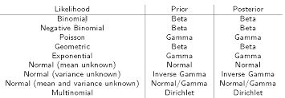
Bayesian Statistics
01
Choosing priors:
Conjugate prior vs. Non-conjugate prior
Proper prior vs. improper prior
Informative prior vs. uninformative prior.
Informative: Using past data to
construct a prior.
We talk about conjugacy when the posterior has
the same structure as the prior when combined
with some likelihood
Notes:
https://people.eecs.berkeley.edu/~jordan/courses/260-spring10/lectures/lecture7.pdf
Advantages of conjugate priors:
This is convenient because a posterior can be used as prior when new data arrives.
In Bayesian approach, processing data one-by -one (online) and in batches is equivalent.

Slide 14
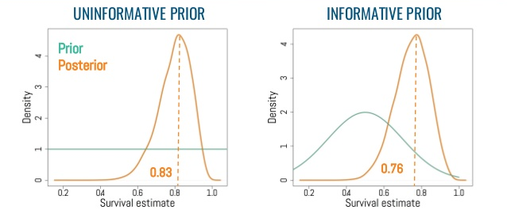
Bayesian Statistics
01
Choosing priors:
Conjugate prior vs. Non-conjugate prior
Informative prior vs. uninformative prior
Proper prior vs. improper prior
Informative: Using past data to
construct a prior.
Informative: there is no past data
relating to your likelihood.
E.g. Jeffrey’s is a non-informative
(objective) prior distribution.
Notes:
https://www.slideshare.net/andreslopezsepulcre/foundations-of-statistics-in-ecology-and-evolution-8-bayesian-statistics

Slide 15
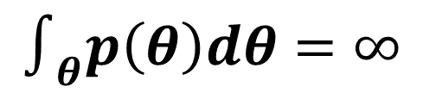
Bayesian Statistics
01
Choosing priors:
Conjugate prior vs. Non-conjugate prior
Informative prior vs. uninformative prior
Proper prior vs. improper prior
Sometimes the Jeffreys prior cannot be normalized, and is thus an improper prior.
Statisticians sometimes use improper priors as uninformative priors.
Note: The posterior distribution exists and integrates to 1.
Improper prior when:
$$∫_{θ}p\left(θ\right)dθ=∞$$
Notes:
This is a prior that doesn’t integrate to 1 (so it is not a proper distribution), but does generate a valid posterior distribution that integrates to 1.
Improper priors are still useful. The posterior will not be of the form of the prior but the posterior will have a tractable form.
Good video to watch:
https://slideplayer.com/slide/5100086/

Slide 16
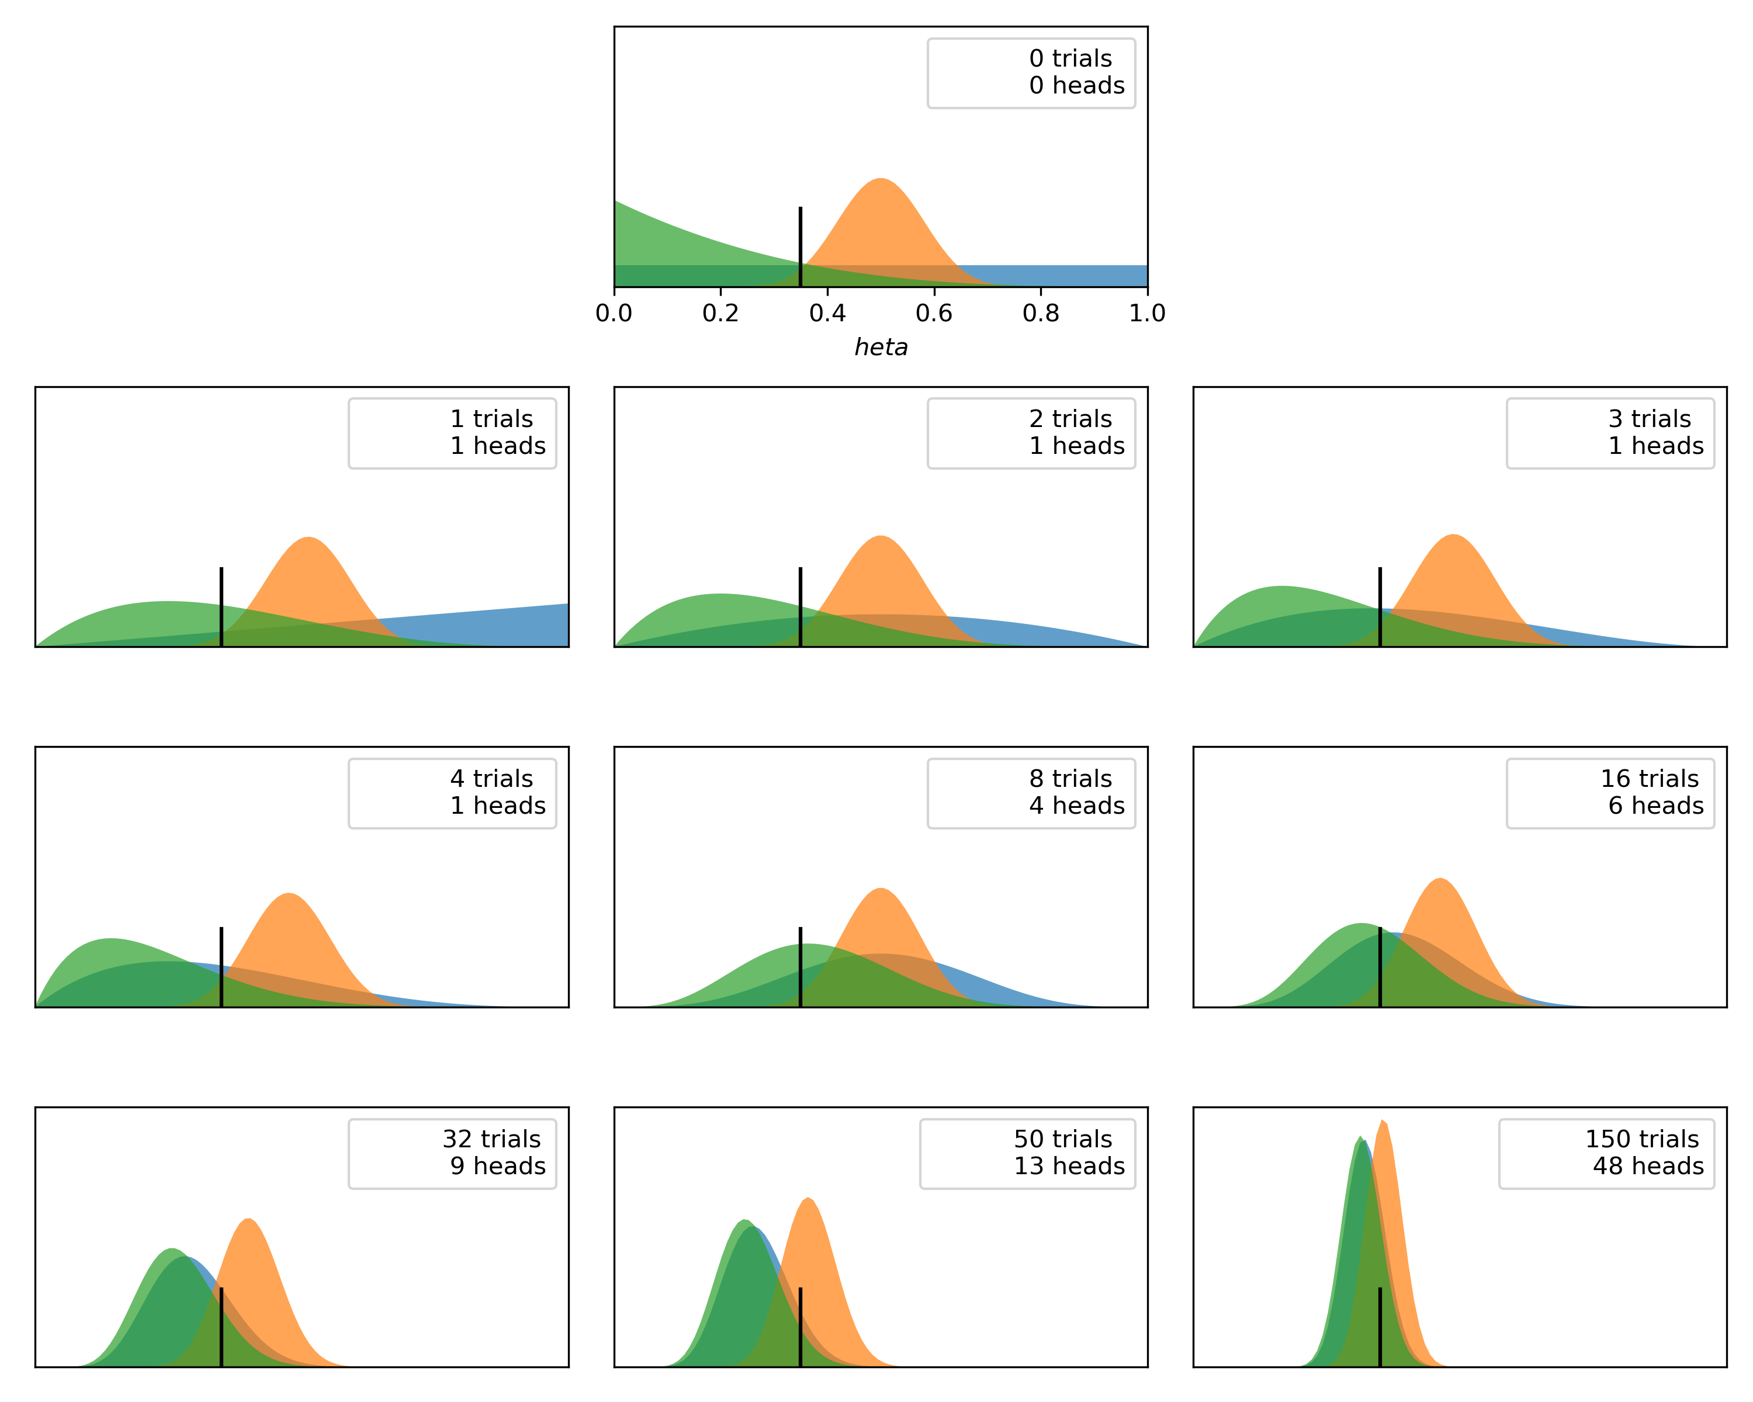
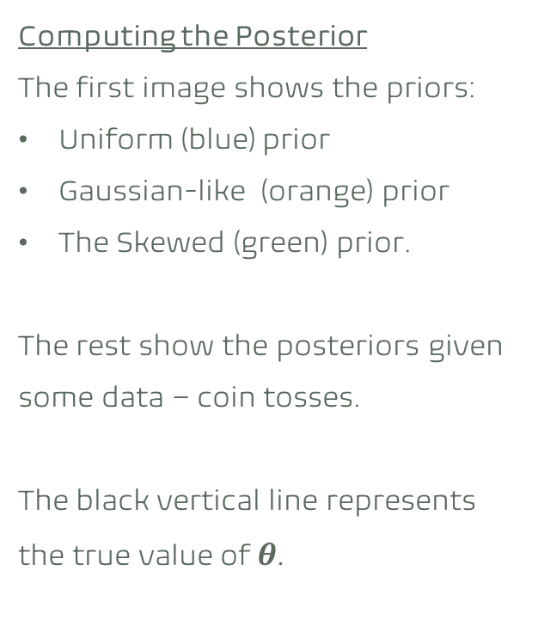
Bayesian Statistics
01
Computing the Posterior
The first image shows the priors:
Uniform (blue) prior
Gaussian-like (orange) prior
The Skewed (green) prior.
The rest show the posteriors given some data – coin tosses.
The black vertical line represents the true value of $θ$.
Notes:
Source : code form the book https://github.com/PacktPublishing/Bayesian-Analysis-with-Python but haven’t seen this code on the github.

Slide 17
Bayesian Statistics
01
What does this mean?
The posterior is not a single value but a distribution of plausible values given data.
The most probable value is given by the mode of the posterior (the peak of the distribution).
The spread of the distribution is proportional to the uncertainty about the parameter.
We are more confident in the result when we have observed more data supporting the result.
Notes:
You can see the blue distribution in the 3rd and 6th plots. – while the mode stays the same, the spread is different, and hence we are more confident in our result in the 6th plot than the 3rd.
Given a sufficiently large data, two or more Bayesian models with different priors. Will tend to converge to the same result. In the limit of infinite data, no matter which prior we use, all of them will provide the same posterior.
How fast the posteriors converge depends on the data and the model. You can see that the green a blue priors converge faster to almost the same distribution, while it take 150 trials for the orange one to converge.

Slide 18
Bayesian Statistics
01
Some additional articles:
Frequentism and Bayesianism III: Confidence, Credibility, and why Frequentism and Science do not Mix here
The difference between MLE and MAP here.

Slide 19
Bayesian Statistics
01
Common interview QS:
Hint: The probability that it's raining on any given day in Seattle is 0.25.
“You're about to get on a plane to London. You want to know if you should bring an umbrella. You call 3 random friends of yours who live there and ask each independently if it's raining. Each of your friends has a 2/3 chance of telling you the truth and a 1/3 chance of messing with you by lying. All 3 friends tell you that "Yes" it is raining. What is the probability that it's actually raining in London?”
Notes:
Answers: https://www.glassdoor.com/Interview/You-re-about-to-get-on-a-plane-to-Seattle-You-want-to-know-if-you-should-bring-an-umbrella-You-call-3-random-friends-of-y-QTN_519262.htm

Slide 20

Introduction
01
We need to define:
Bayesian Statistics
Markov Chains
Markov Chain Monte Carlo methods
MCMC
Metropolis Hastings algorithm

Slide 21
Brief Introduction to Markov Chains
02

Slide 22
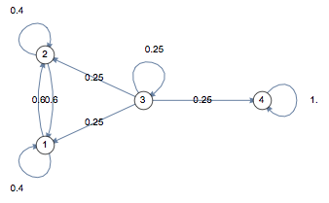
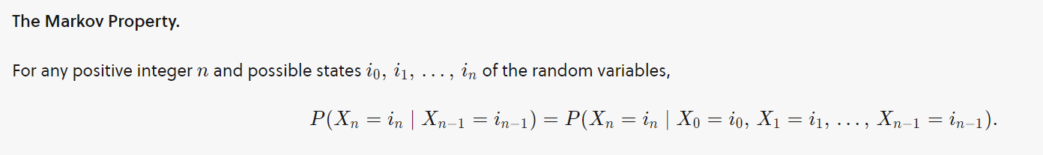
Markov Chain
02
Markov Chain is essentially a fancy term for a random walk on a graph.
A Markov chain is a discrete-time stochastic process that progresses from one state to another with certain probabilities that can be represented by a graph and state transition matrix P.
Knowledge of the previous state is all that is necessary to determine the probability distribution of the current state.
Source: https://towardsdatascience.com/markov-chain-analysis-and-simulation-using-python-4507cee0b06e
Notes:
https://brilliant.org/wiki/markov-chains/#markov-chain

Slide 23
Markov Chain
02
Conditions for existence of a unique stationary distribution:
(In order for the Metropolis-Hastings algorithm to work, we need the following to be true for the Markov Chain)
Irreducible Markov Chain
The transition graph is connected (any state can be reached).
Aperiodic Markov Chain
State trajectories drawn from the transition don’t get trapped into cycles.
Not transient
MCMC samplers are irreducible and aperiodic MCs that converge to the target distribution.
Source: https://www.cs.cmu.edu/~epxing/Class/10708-15/notes/10708_scribe_lecture17.pdf
Notes:
https://brilliant.org/wiki/transience-and-recurrence/

Slide 24
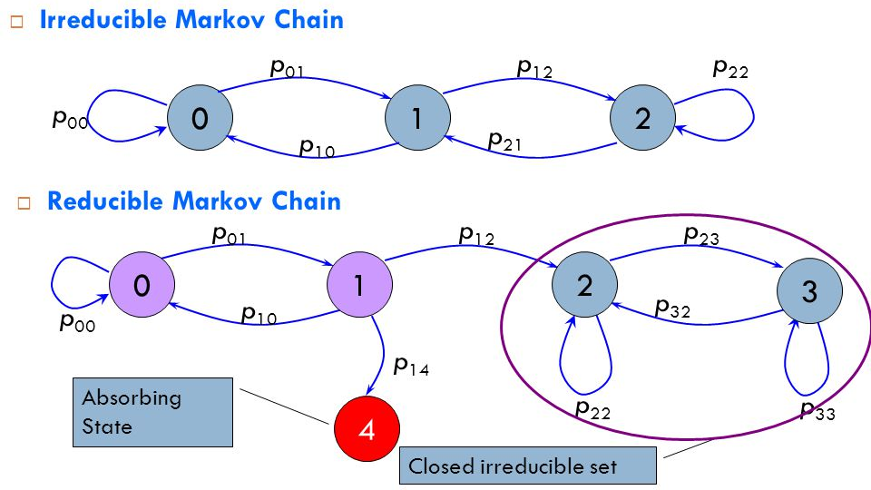
Markov Chain
02
The transition graph is connected (any state can be reached).
Notes:
https://slideplayer.com/slide/4238945/
nodes (also often called states)

Slide 25
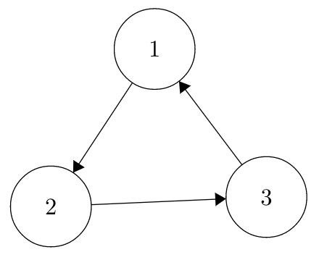
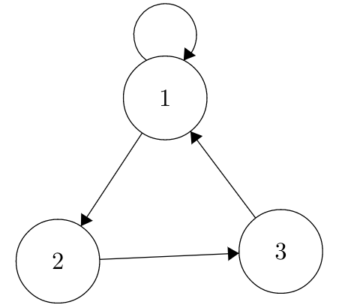
Markov Chain
02
Aperiodic vs Periodic
State trajectories drawn from the transition don’t get trapped into cycles
Notes:
https://bookdown.org/probability/beta/markov-chains.html

Slide 26
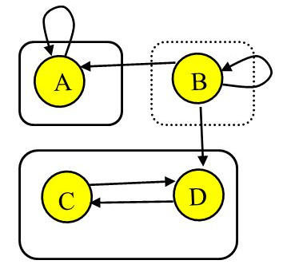
Markov Chain
02
Recurrent if: starting from any state, and from wherever you can go, there is a way of returning to the initial state i.
Transient if not recurrent.
A, C and D are recurrent states.
B is transient state.
Source: https://www.youtube.com/watch?app=desktop&v=wSQaYn2h-e8
Notes:
https://bookdown.org/probability/beta/markov-chains.html
https://slideplayer.com/slide/3236427/

Slide 27
Introduction
02
We need to define:
Bayesian Statistics
Markov Chains
Monte Carlo methods
MCMC
Metropolis Hastings algorithm

Slide 28
Brief Intro to Monte Carlo Methods
03

Slide 29
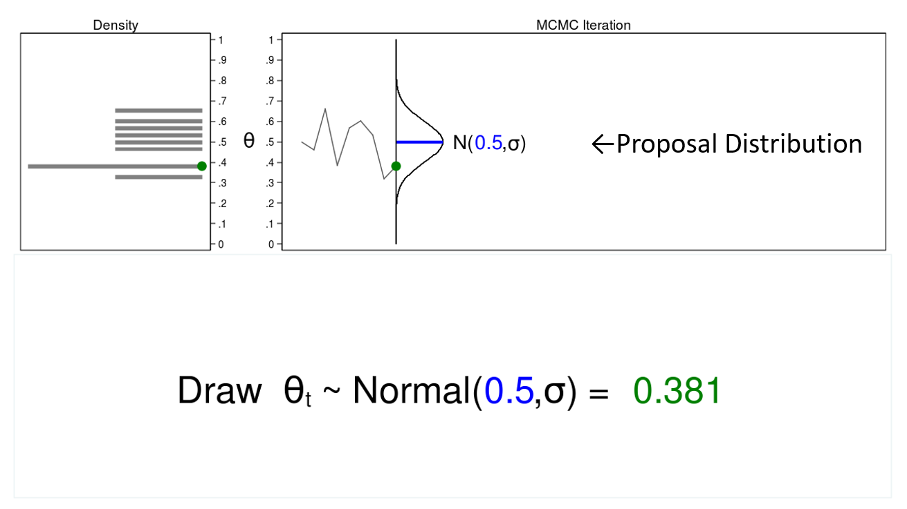
Monte Carlo
03
The term “Monte Carlo” refers to methods that rely on the generation of numbers.
The figure illustrates some features of a Monte Carlo experiment.
Histogram of
the sample
Trace plot
Notes:
Notes explaining the MC, MCMC and M-H algorithm are taken from https://blog.stata.com/2016/11/15/introduction-to-bayesian-statistics-part-2-mcmc-and-the-metropolis-hastings-algorithm/

Slide 30
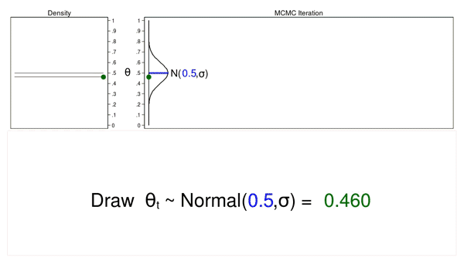
Monte Carlo
03
The proposal distribution does not change from one iteration to the next.
The density plot looks more and more like the proposal distribution as the sample size increases.
The trace plot is stationary—the pattern of variation looks the same over all iterations.
Our Monte Carlo simulation generated a sample that looks much like the proposal distribution, and sometimes that’s all we need. But we will require additional tools to generate a sample from our posterior distribution.
Notes:
https://blog.stata.com/2016/11/15/introduction-to-bayesian-statistics-part-2-mcmc-and-the-metropolis-hastings-algorithm/

Slide 31
Introduction
03
We need to define:
Bayesian Statistics
Markov Chains
Monte Carlo methods
MCMC
Metropolis Hastings algorithm

Slide 32
Brief Intro to MCMC
04

Slide 33
Markov Chain Monte Carlo
04
The problem statement:
In the last few Bayesian examples the posterior distribution was easy to identify (e.g. conjugate priors).
However, in practice this is not usually the case and therefore, via Bayes Theorem, we would only know the posterior distribution up to a constant. This motivates the idea of using Monte Carlo simulation methods.
How can we sample from a distribution that we do not know?

Slide 34
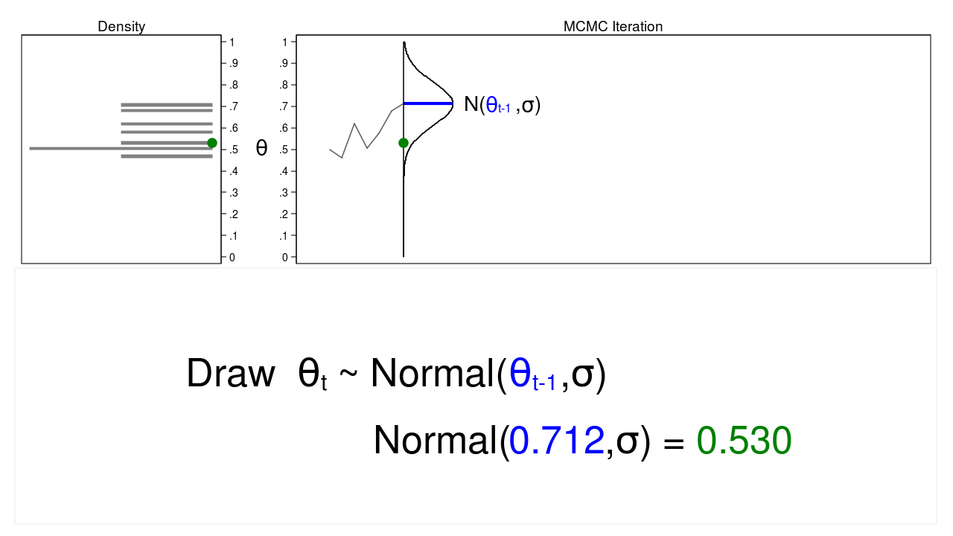
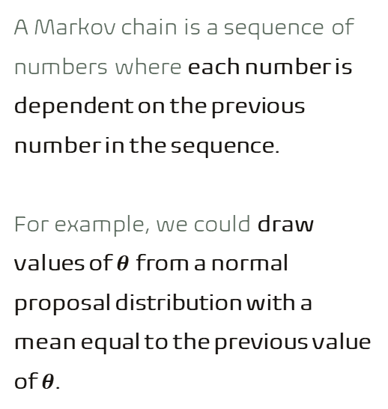
Markov Chain Monte Carlo
04
A Markov chain is a sequence of numbers where each number is dependent on the previous number in the sequence.
For example, we could draw values of $θ$ from a normal proposal distribution with a mean equal to the previous value of $θ$.
Notes:
Figure 2 shows a trace plot and a density plot where the current value of θ (θt=0.530) was drawn from a proposal distribution with a mean equal to the previous value of θ (θt−1=0.712)
https://blog.stata.com/2016/11/15/introduction-to-bayesian-statistics-part-2-mcmc-and-the-metropolis-hastings-algorithm/

Slide 35
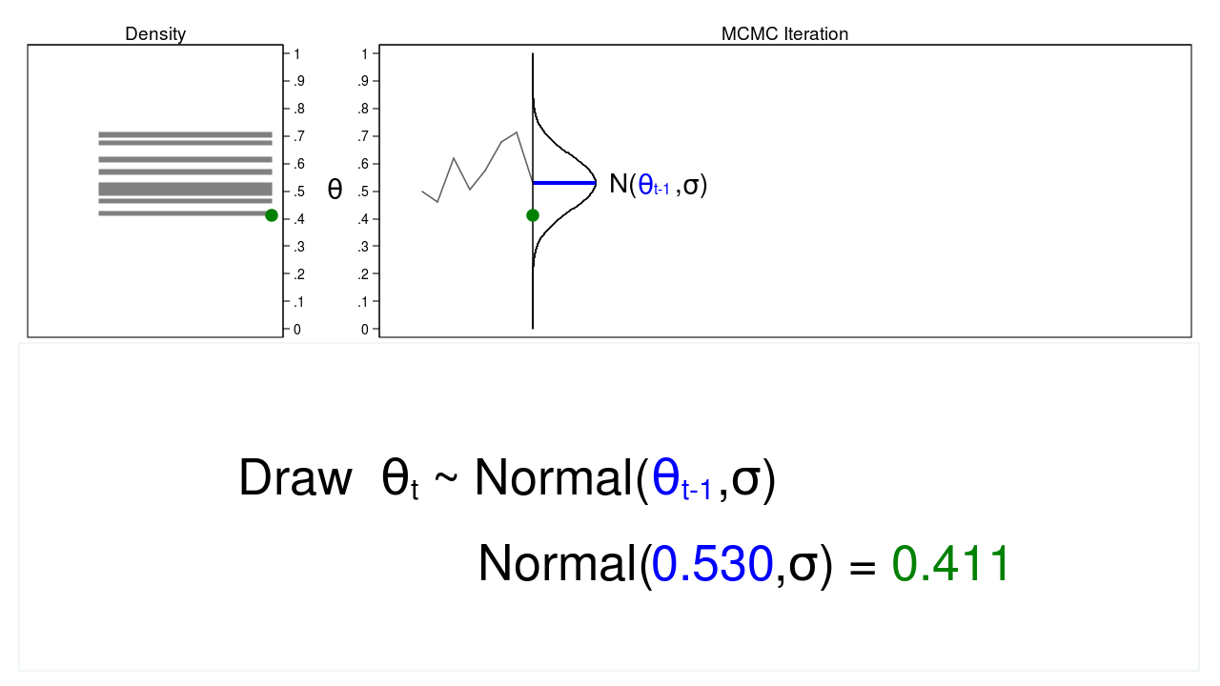
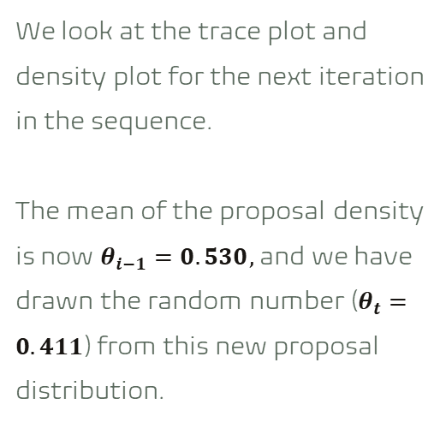
Markov Chain Monte Carlo
04
We look at the trace plot and density plot for the next iteration in the sequence.
The mean of the proposal density is now $θ_{i−1}=0.530,$ and we have drawn the random number ($θ_{t}=0.411$) from this new proposal distribution.
Notes:
https://blog.stata.com/2016/11/15/introduction-to-bayesian-statistics-part-2-mcmc-and-the-metropolis-hastings-algorithm/

Slide 36
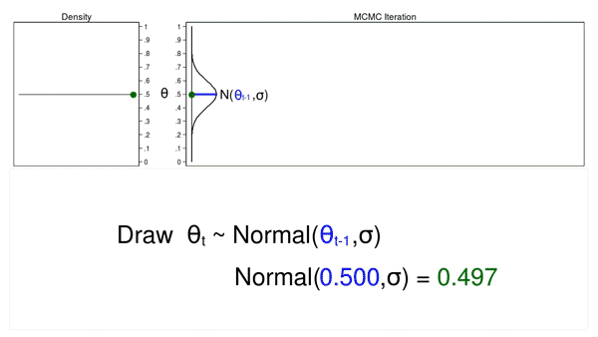
Markov Chain Monte Carlo
04
The proposal distribution is changing with each iteration. This creates a trace plot with a “random walk” pattern: the variability is not the same over all iterations.
The resulting density plot does not look like the proposal distribution or any other useful distribution. It certainly doesn’t look like a posterior distribution.
Draw 10,000 random values of θ using MCMC
Notes:
https://blog.stata.com/2016/11/15/introduction-to-bayesian-statistics-part-2-mcmc-and-the-metropolis-hastings-algorithm/

Slide 37

Markov Chain Monte Carlo
04
When was Monte Carlo method first introduced?
The Monte Carlo method was crucial for the simulations needed during the ‘Manhattan project’ during World War II to develop the first nuclear weapons.
In 1946 Von Neumman (better known as the father of Game Theory) and his colleague Ulam formalised the concept. They were investigating radiation shielding and the distance that neutrons would likely travel through various materials. Although they had enough data, the physicists in the lab were unable to solve the problem using conventional analytical math, then, Ulam had the idea of using random experiments with ‘truly random’ numbers.
At the time, this project was kept secret and they required a codename; it was Ulam who suggested the name of Monte Carlo. He got the inspiration from his uncle, who seemed to be an adept of ‘Casino de Monte-Carlo’ in Monaco where he would spend his time gambling family money.
Source: https://medium.com/analytics-vidhya/neural-networks-in-finance-markov-chain-monte-carlo-mcmc-and-stochastic-volatility-modelling-3f4f148c3046
Notes:
Another source: file:///C:/Users/iveli/Downloads/Andrieu2003_Article_AnIntroductionToMCMCForMachine.pdf

Slide 38
MCMC
04
Weaknesses:
MCMC are computationally slow.
It is difficult to determine how many steps are needed to converge to the stationary distribution within an acceptable error. (the convergence of an MCMC algorithm is a convergence in distribution not a point).
Typically, MCMC sampling can only approximate the target distribution, as there is always some residual effect of the starting position
Using the output of an MCMC algorithm that has not converged may lead to incorrect inferences on the problem at hand

Slide 39
Markov Chain Monte Carlo - MCMC
04
Real world examples where we have used MCMC:
Modelling sunspot counts over time here.
Predicting the number of goals in the World Cup here
Simulating stock prices here.
S&P 500 price model here.
Simulating the 2016 US Presidential Election here.
Simulating Hamiltonian dynamics here.

Slide 40
Introduction
04
We need to define:
Bayesian Statistics
Markov Chains
Monte Carlo methods
MCMC
Metropolis Hastings algorithm

Slide 41
The Metropolis-Hastings Algorithm
05

Slide 42
MH algorithm
05
The reason MCMC alone failed to generate a sample from the posterior distribution is that we haven’t incorporated any information about the posterior distribution into the process of generating the sample. We could improve our sample by keeping proposed values of θ that are more likely under the posterior distribution and discarding values that are less likely.
But the obvious difficulty with accepting and rejecting proposed values of θ based on the posterior distribution is that we usually don’t know the functional form of the posterior distribution. If we knew the functional form, we could calculate probabilities directly without generating a random sample.
So how can we accept or reject proposed values of θ without knowing the functional form?
One answer is the Metropolis–Hastings algorithm.
Notes:
https://blog.stata.com/2016/11/15/introduction-to-bayesian-statistics-part-2-mcmc-and-the-metropolis-hastings-algorithm/

Slide 43

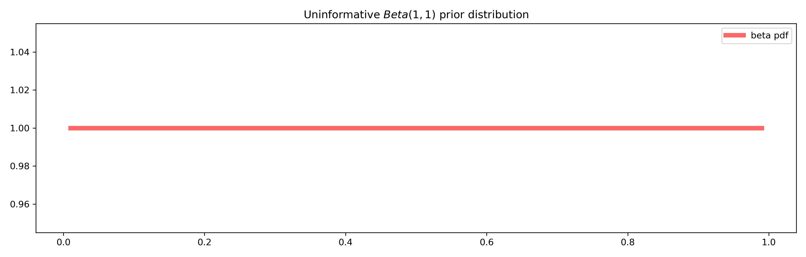
MH algorithm
05
Suppose we are interested in the posterior distribution of the parameter θ, which is the probability that a coin toss results in “heads”.
Our prior distribution is a flat, uninformative beta distribution with parameters 1 and 1.
We will use a binomial likelihood function to quantify the data from our experiment.
We will also use MCMC with the M–H algorithm to generate a sample from the posterior distribution of θ.
We can then use this sample to estimate things such as
the mean or median of the posterior distribution,
a 95% credible interval,
or the probability that θ falls within an arbitrary interval.
Notes:
Notes explaining the MC, MCMC and M-H algorithm are taken from https://blog.stata.com/2016/11/15/introduction-to-bayesian-statistics-part-2-mcmc-and-the-metropolis-hastings-algorithm/

Slide 44
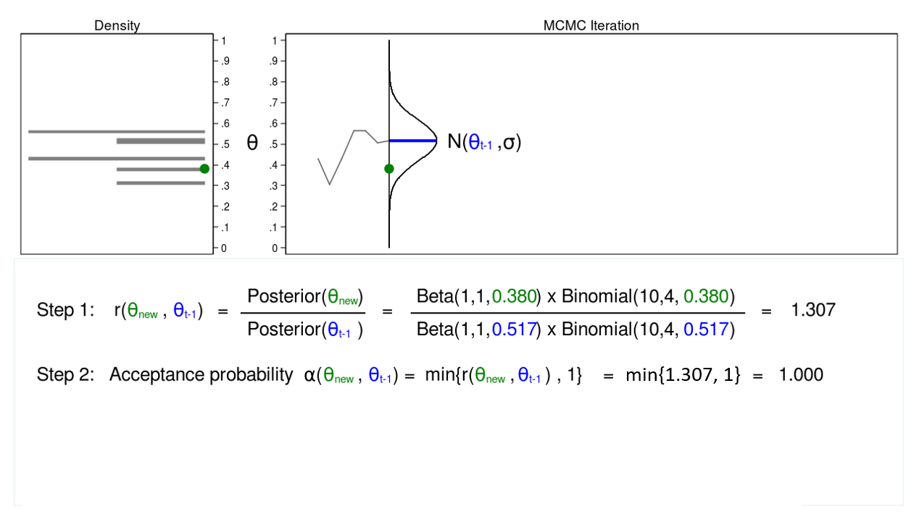
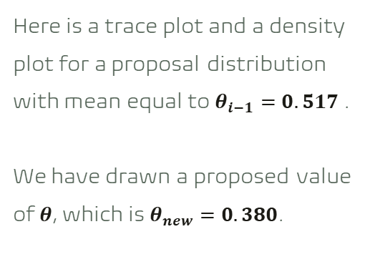
MH algorithm
05
Here is a trace plot and a density plot for a proposal distribution with mean equal to $θ_{i−1}=0.517$.
We have drawn a proposed value of $θ$, which is $θ_{new}=0.380$.
Notes:
https://blog.stata.com/2016/11/15/introduction-to-bayesian-statistics-part-2-mcmc-and-the-metropolis-hastings-algorithm/

Slide 45
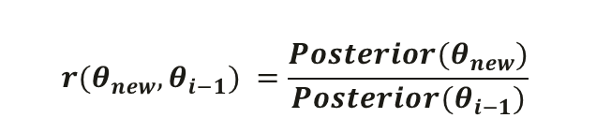
MH algorithm
05
Step 1:
Calculate the ratio:
we can substitute the product of the prior distribution and the likelihood function.
The ratio in here is 1.307.
$$r(θ_{new}, θ_{i−1}) =\frac{Posterior(θ_{new})}{Posterior(θ_{i−1})}$$
Notes:
https://blog.stata.com/2016/11/15/introduction-to-bayesian-statistics-part-2-mcmc-and-the-metropolis-hastings-algorithm/

Slide 46
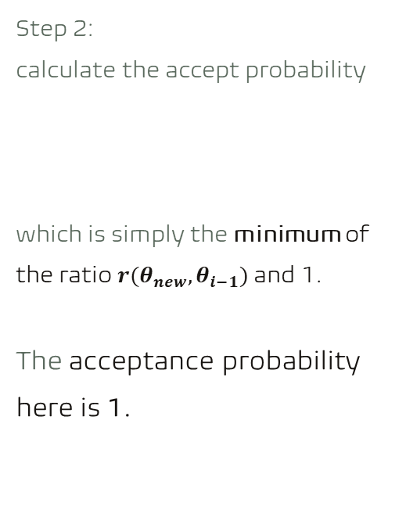

MH algorithm
05
Step 2:
calculate the accept probability
which is simply the minimum of the ratio $r(θ_{new}, θ_{i−1})$and 1.
The acceptance probability here is 1.
$$α(θ_{new}, θ_{i−1})$$
Step 2 is necessary because probabilities must fall between 0 and 1.
Notes:
https://blog.stata.com/2016/11/15/introduction-to-bayesian-statistics-part-2-mcmc-and-the-metropolis-hastings-algorithm/

Slide 47
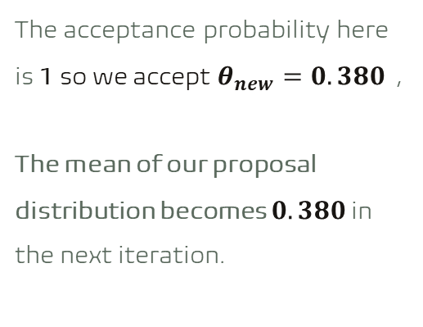
MH algorithm
05
The acceptance probability here is 1 so we accept $θ_{new}=0.380$ ,
The mean of our proposal distribution becomes $0.380$ in the next iteration.
Notes:
https://blog.stata.com/2016/11/15/introduction-to-bayesian-statistics-part-2-mcmc-and-the-metropolis-hastings-algorithm/

Slide 48
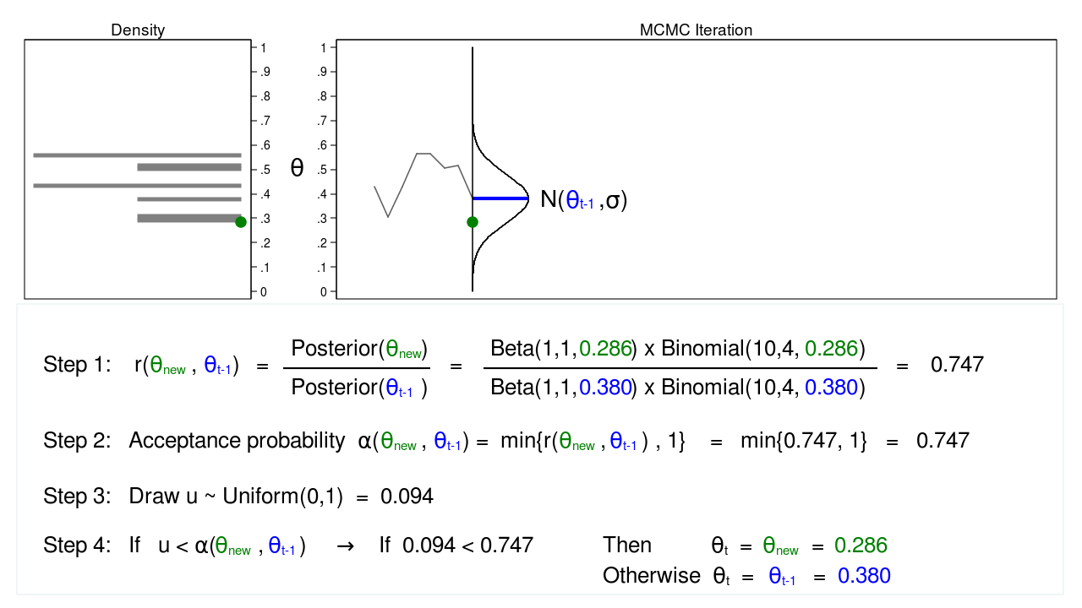
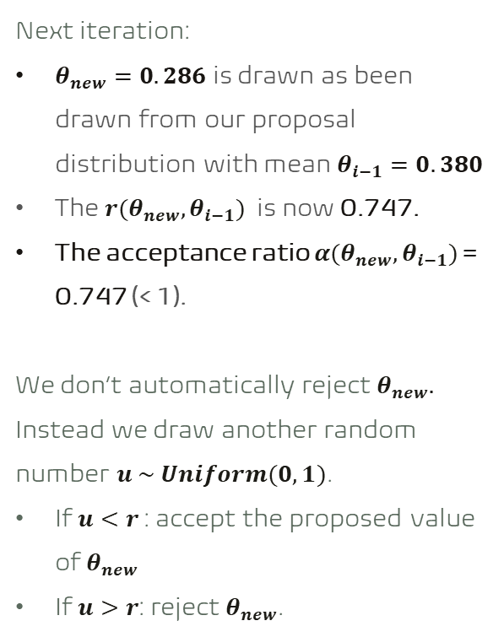
MH algorithm
05
Next iteration:
$θ_{new}=0.286$ is drawn as been drawn from our proposal distribution with mean $θ_{i−1}=0.380$
The $r(θ_{new}, θ_{i−1})$ is now 0.747.
The acceptance ratio $α(θ_{new}, θ_{i−1})$ = 0.747 (< 1).
We don’t automatically reject $θ_{new}.$
Instead we draw another random number $u \sim Uniform(0,1)$.
If $u<r$ : accept the proposed value of $θ_{new}$
If $u>r$: reject $θ_{new}$.
Notes:
https://blog.stata.com/2016/11/15/introduction-to-bayesian-statistics-part-2-mcmc-and-the-metropolis-hastings-algorithm/

Slide 49
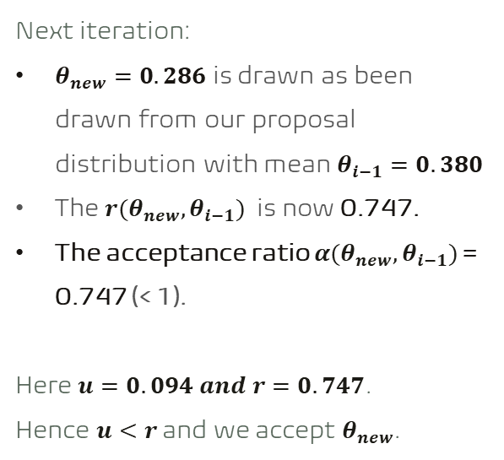
MH algorithm
05
Next iteration:
$θ_{new}=0.286$ is drawn as been drawn from our proposal distribution with mean $θ_{i−1}=0.380$
The $r(θ_{new}, θ_{i−1})$ is now 0.747.
The acceptance ratio $α(θ_{new}, θ_{i−1})$ = 0.747 (< 1).
Here $u=0.094 and r=0.747$.
Hence $u<r$ and we accept $θ_{new}$.
Notes:
https://blog.stata.com/2016/11/15/introduction-to-bayesian-statistics-part-2-mcmc-and-the-metropolis-hastings-algorithm/

Slide 50
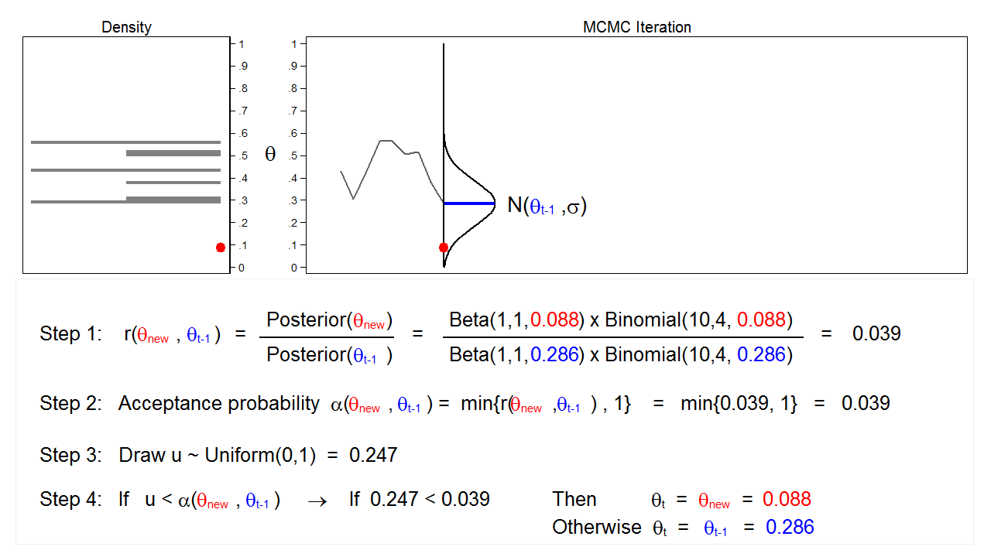
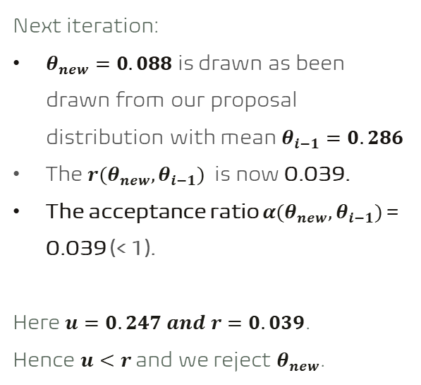
MH algorithm
05
Next iteration:
$θ_{new}=0.088$ is drawn as been drawn from our proposal distribution with mean $θ_{i−1}=0.286$
The $r(θ_{new}, θ_{i−1})$ is now 0.039.
The acceptance ratio $α(θ_{new}, θ_{i−1})$ = 0.039 (< 1).
Here $u=0.247 and r=0.039$.
Hence $u<r$ and we reject $θ_{new}$.
Notes:
https://blog.stata.com/2016/11/15/introduction-to-bayesian-statistics-part-2-mcmc-and-the-metropolis-hastings-algorithm/

Slide 51
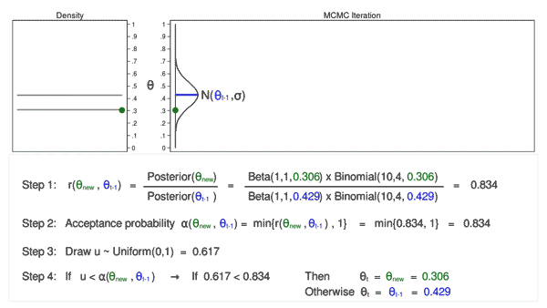
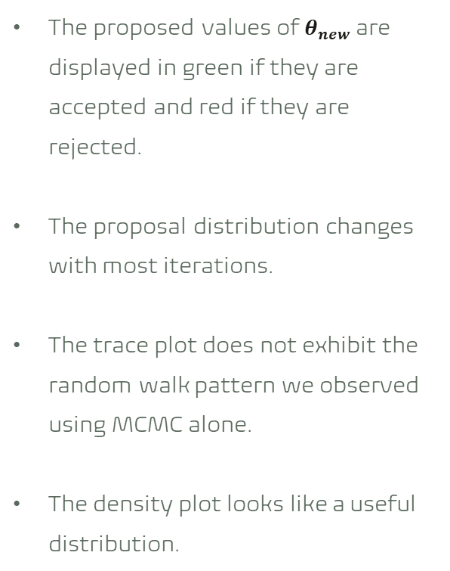
MH algorithm
05
The proposed values of $θ_{new}$ are displayed in green if they are accepted and red if they are rejected.
The proposal distribution changes with most iterations.
The trace plot does not exhibit the random walk pattern we observed using MCMC alone.
The density plot looks like a useful distribution.
Draw 10,000 random values of θ using MCMC with the M–H algorithm
Notes:
https://blog.stata.com/2016/11/15/introduction-to-bayesian-statistics-part-2-mcmc-and-the-metropolis-hastings-algorithm/

Slide 52
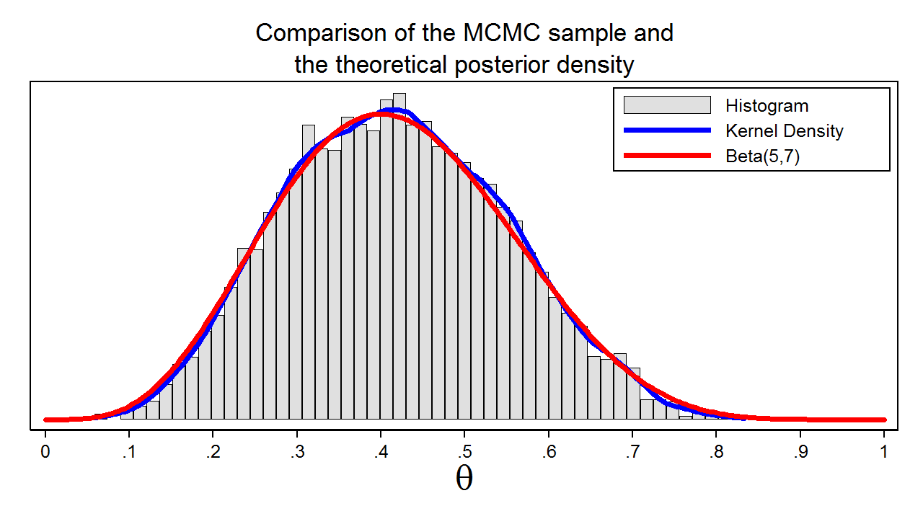
MH algorithm
05
In this example, we know that the posterior distribution is a beta distribution with parameters 5 and 7.
The red line shows the analytical posterior distribution
The blue line is a kernel density plot for our sample.
The kernel density plot is quite similar to the Beta(5,7) distribution, which suggests that our sample is a good approximation to the theoretical posterior distribution.
Histogram of the sample that we generated using MCMC with the M–H algorithm
Notes:
We could then use our sample to calculate the mean or median of the posterior distribution, a 95% credible interval, or the probability that θ falls within an arbitrary interval.

Slide 53
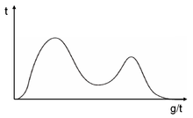
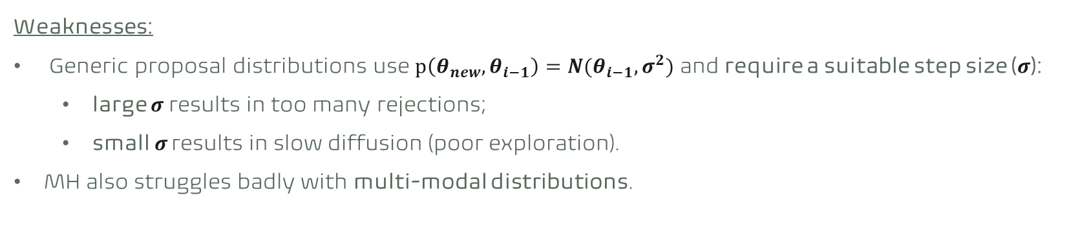
MH algorithm
05
Weaknesses:
Generic proposal distributions use $p\left(θ_{new}, θ_{i−1}\right)=N(θ_{i−1}, σ^{2})$ and require a suitable step size ($σ$):
large $σ$ results in too many rejections;
small $σ$ results in slow diffusion (poor exploration).
MH also struggles badly with multi-modal distributions.
Source: https://www.cs.cmu.edu/~epxing/Class/10708-15/notes/10708_scribe_lecture17.pdf
Notes:
https://arxiv.org/pdf/q-bio/0505002.pdf

Slide 54
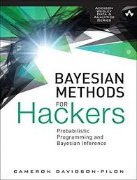
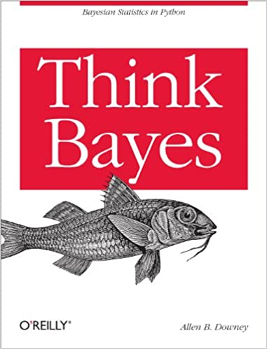
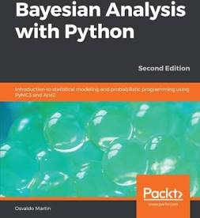
Some easy-to-understand resources
06
GitHub code
Book & GitHub
GitHub
Notes:
k-means clustering tries to group similar kinds of items in form of clusters. It finds the similarity between the items and groups them into the clusters
Resource: https://realpython.com/k-means-clustering-python/

Slide 55




Software we can use
07

Slide 56
Closing Q&A
08
Thank you.

